Slide 1

Epileptic Seizure Detection and Notification System
Preliminary Design Review
Team #19063
Sponsors - Iwan R Grau, James McDowell, Palanivel Guruvareddiar
Mentor - Catherine Merrill
Team members:
Alejandro Ortega
Gordon Downs
Louie Bertani
Juan Gastélum
K Humberto Lopez-Felix
Oanh Tran

Slide 2
Objectives of the PDR
Our objectives for PDR are to demonstrate:
Understanding of the functional and system requirements that define the SDNS, as well as the environmental conditions required for the correct operation of the system.
To present the identification of the most critical functions required for the success of the project, thus the definition of our MVP based on Risk: Gathering as much real clinical data as possible.
To communicate the proposed verification methods for the system requirements that encompass our MVP.
We are ready to build and verify our MVP SDNS.
Notes:
Alejandro:

Slide 3
PDR Overview
Introduction
System Requirements Section
System Architecture
System Block Diagram
System Requirements and SRVM
Concept, Trade Studies and Point Design
Design Considerations
Trade Studies
Final Design Concept
Risk Analysis and Mitigation
System Architecture and Requirements Prioritization
Model & Analyses
MVP Description
Model and Analyses
Test Plans for MVP
Status, Deliverables and Cost Analysis
Summary

Slide 4


Introduction
1 in every 1,000 individuals with epilepsy dies from sudden unexpected death in epilepsy.^{1,2} Awareness of the incident and providing first aid assistance reduces the likelihood of this tragedy from occurring.^{1,2}
Seizures can occur when least expected, impacting the lifestyles of the individual and those caring for them.
Given the stressful circumstances of the condition, the affected individuals extends past the individual experiencing the episode.
We are delivering a monitoring system that detects seizures and notifies caregivers to reduce SUDEP risk.
¹https://www.epilepsy.com/learn/early-death-and-sudep/sudep/sudep-faq
²https://www.cdc.gov/epilepsy/about/sudep/index.htm
Notes:
Juan
Here we need to add a short introduction that explains what is our project and why are we doing it? What is the purpose of dedicating time to build such system.
This supports our thesis statement since we explain our understanding of the project from a high-level perspective and we understand why it is significant to build such system, endorsing the fact that we are ready to start building and verifying our MVP

Slide 5
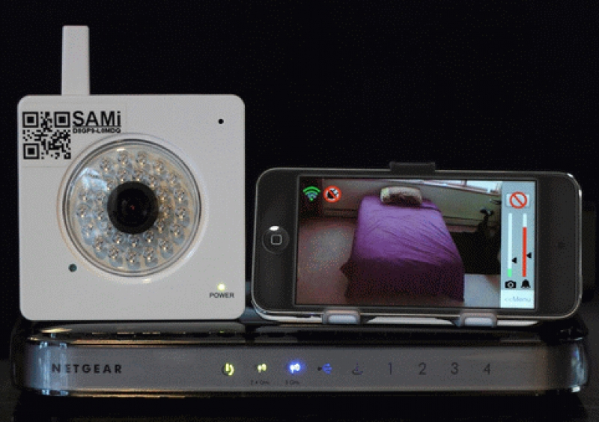
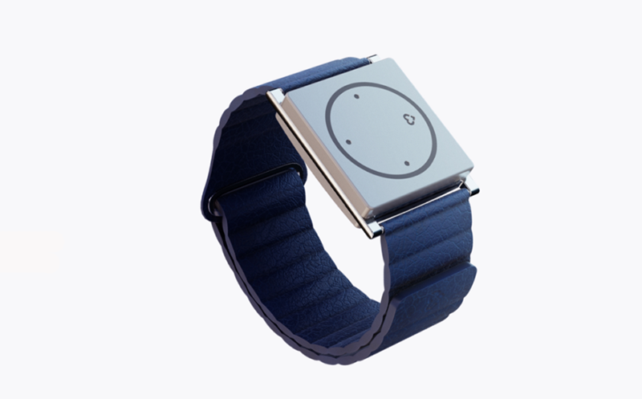
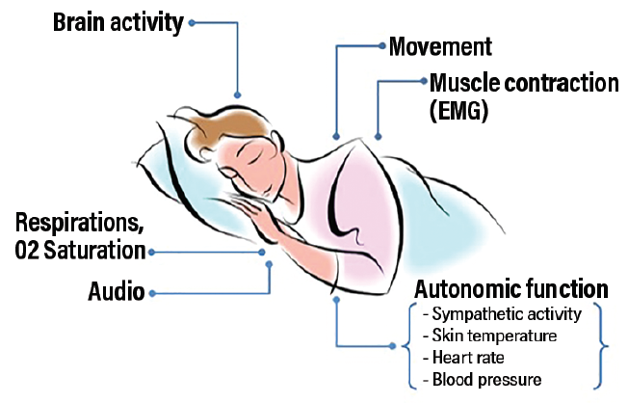
Introduction
Many systems that advertise seizure detection currently exist. Many of them can be unreliable and often involve an apparatus that has to be attached to the affected individual.
Our proposed system will detect seizures allowing caregivers to leave affected individual to the privacy of their bed while preserving comfort.
Success in our system will be determined by the accuracy in which the system can detect and alert, effectively improving the lives of those affected by the condition.
Notes:
Juan
Given the introduction, here we need to add the boundaries that define our system. Functional Block Diagram here is useful with the ConOps as well.
The second important part here is the system environment: What are the conditions our system will operate correctly in? Temperature? Pressure? Light?
Here we explain what the boundaries are for our system and what its operational environment will be. This connects with our first objective of demonstrating understanding of the environmental conditions required for our system to operate correctly.
https://practicalneurology.com/articles/2018-nov-dec/seizure-detection-and-sudep-prevention

Slide 6
PDR Overview
Introduction
System Requirements Section
System Architecture
System Block Diagram
System Requirements and SRVM
Concept, Trade Studies and Point Design
Design Considerations
Trade Studies
Final Design Concept
Risk Analysis and Mitigation
System Architecture and Requirements Prioritization
Model & Analyses
MVP Description
Model and Analyses
Test Plans for MVP
Status, Deliverables and Cost Analysis
Summary

Slide 7
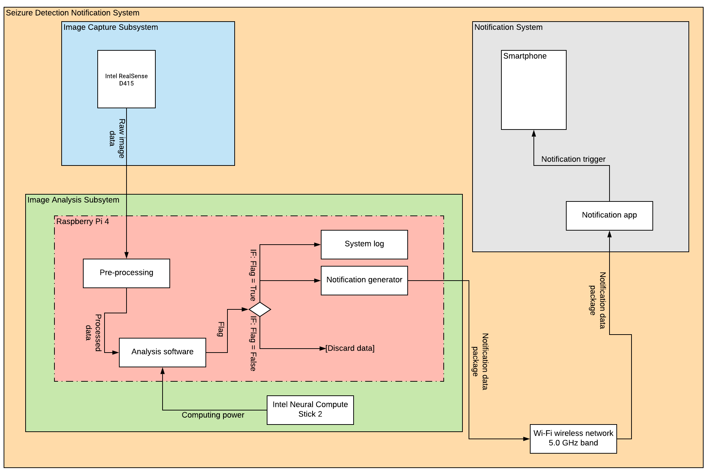
System Block Diagram
The system is comprised of sub-systems based on required functionality.
Notes:
Juan
Present the system block diagram to show how the different subsystems and components are connected and how they work together at a high level. Start with the overarching SBD, this gives context for the rest.
With this slide, we demonstrate our understanding of the system as a set of connected subsystems that communicate in a specific way to achieve the desired task. Subsystems were defined from our functional requirements and ConOps, which demonstrates how our high-level understanding of the system slowly flows down to the sub-system level. This connects with our first objective on slide 3

Slide 8
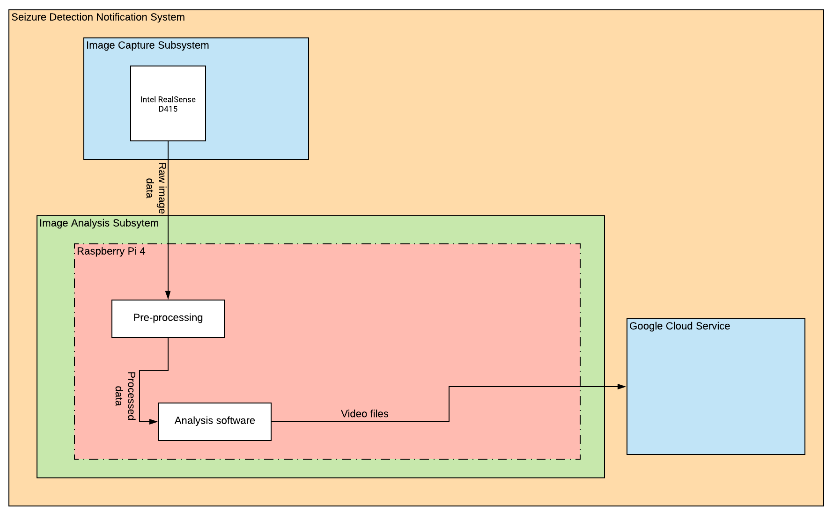
Proposed System Block Diagram (MVP)
The MVP system is comprised of subsystems based on data collection requirements.
Notes:
Juan
Present the system block diagram to show how the different subsystems and components are connected and how they work together at a high level. Start with the overarching SBD, this gives context for the rest.
With this slide, we demonstrate our understanding of the system as a set of connected subsystems that communicate in a specific way to achieve the desired task. Subsystems were defined from our functional requirements and ConOps, which demonstrates how our high-level understanding of the system slowly flows down to the sub-system level. This connects with our first objective on slide 3

Slide 9
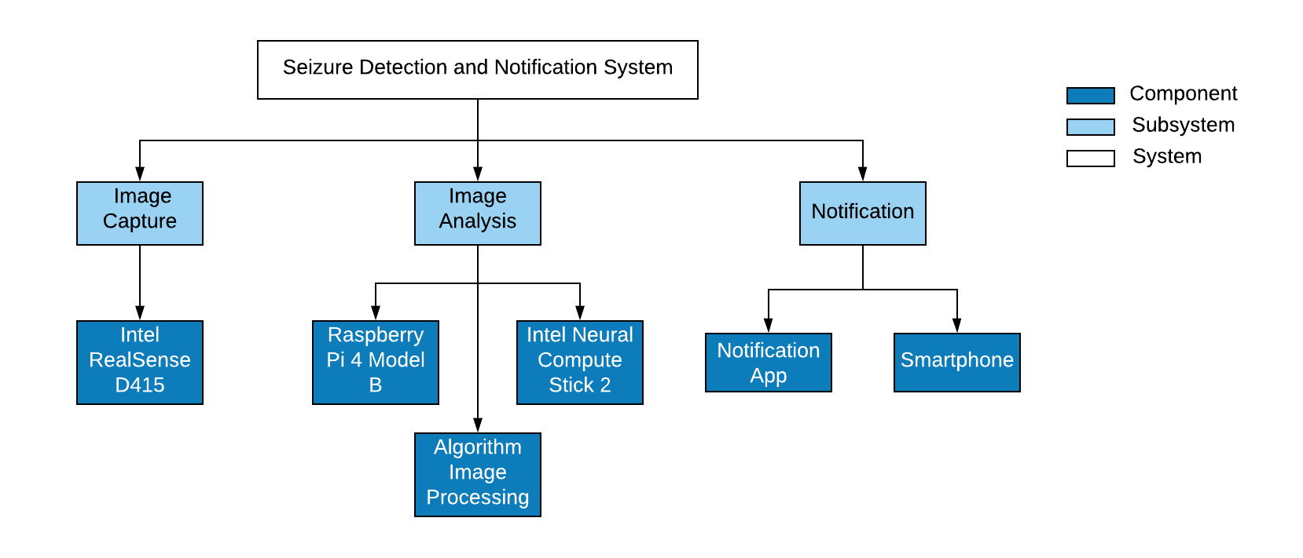
System Architecture
System is organized in a hierarchical architecture following the system Block Diagram and the logical flow down of functional requirements.
Notes:
Oanh
Present our system architecture so that sponsors and mentors can observe the various sub-systems and components that comprise the SDNS at a high level.
This slide demonstrates that we understand the functional requirements enough to flow them down to the component level so that we can define subsystems and components necessary for the operation of the system, and organize them in a logical hierarchy. This connects with our first objective in slide 3.

Slide 10
System Requirements & SRVM
System Requirements | T | A | D | I
1.1 The system shall capture images at a rate above 16 fps. | x
1.2 The system shall perform steady-state processing at rate above 16 fps. | x | x
1.3 The system shall detect a seizure with at least 90 percent accuracy. | x | x
1.4 The system shall detect a seizure within 10 seconds of the clonic phase starting. | x
1.5 The system shall operate independently from the presence of visible light, in room-ambient conditions. | x
The system requirements are understood and
define the performance and operational conditions of SDNS.
Blue: Applies to MVP
Notes:
Oanh
Here we present the system requirements that define the SDNS based on what it should to to achieve its function. Comparing this with the system architecture and System Block Diagram will provide insight into how each sub-system or component has to perform in order to achieve the desired function. List all System Requirements with their verification. Highlight only one or two based on what flows to your MVP as these should be the most important NOW.
Here we present all of our system requirements which demonstrates understanding of the functional requirements of the system and the logical construction of system requirements based off this. The most important ones (MVP System Requirements) are highlighted which connects with our first and second Objectives on slide 3.

Slide 11
System Requirements & SRVM
System Requirements | T | A | D | I
2.1 The system shall trigger an alarm whenever a seizure is detected. | x
2.2 The system shall deliver alerts to the caregivers' smartphone wirelessly. | x
2.3 The alarm shall trigger within 5 seconds of the seizure being detected. | x
The system requirements are understood and
define the performance and operational conditions of SDNS.
Notes:
Oanh
Here we present the system requirements that define the SDNS based on what it should to to achieve its function. Comparing this with the system architecture and System Block Diagram will provide insight into how each sub-system or component has to perform in order to achieve the desired function. List all System Requirements with their verification. Highlight only one or two based on what flows to your MVP as these should be the most important NOW.
Here we present all of our system requirements which demonstrates understanding of the functional requirements of the system and the logical construction of system requirements based off this. The most important ones (MVP System Requirements) are highlighted which connects with our first and second Objectives on slide 3.

Slide 12
System Requirements & SRVM
System Requirements | T | A | D | I
3.1 The system shall keep a log file that contains a running list of up to 1,000 times at which seizures were detected by the system, with FIFO protocol. | x
3.2 The system shall output the log file on command. |  |  |  | x
The system requirements are understood and
define the performance and operational conditions of SDNS.
Notes:
Oanh
Here we present the system requirements that define the SDNS based on what it should to to achieve its function. Comparing this with the system architecture and System Block Diagram will provide insight into how each sub-system or component has to perform in order to achieve the desired function. List all System Requirements with their verification. Highlight only one or two based on what flows to your MVP as these should be the most important NOW.
Here we present all of our system requirements which demonstrates understanding of the functional requirements of the system and the logical construction of system requirements based off this. The most important ones (MVP System Requirements) are highlighted which connects with our first and second Objectives on slide 3.

Slide 13
PDR Overview
Introduction
System Requirements Section
System Architecture
System Block Diagram
System Requirements and SRVM
Concept, Trade Studies and Point Design
Design Considerations
Trade Studies
Final Design Concept
Risk Analysis and Mitigation
System Architecture and Requirements Prioritization
Model & Analyses
MVP Description
Model and Analyses
Test Plans for MVP
Status, Deliverables and Cost Analysis
Summary

Slide 14
Design Considerations
Performance was prioritized since there are commercial systems that attempt to detect seizures, but perform poorly.
Trade Studies were made to reach our point design taking into account:
Low-Light Performance (Camera)
Detection under bed sheet (Camera)
Computational Power at edge (Computer)
Cost-Effectiveness (Camera + Computer)
Access to Training Data (Image Algorithm)
Perform Trade Studies based on previous items
Sponsor input, budget and limitations played a role in shaping the system.
Notes:
Alejandro
Here the plan is to show what we considered when coming up with our design based on the requirements from our sponsors, our skill set as engineers, the environment and user of the system, and how those considerations lead our design and trade studies process
This slide presents the considerations we took prior starting the design and trade studies for our system. This demonstrates our understanding of the goals and limitations of our project and connects with our first objective in slide 3.
Considerations:
Maximize reliability of detection and notification
Maximize cost effectiveness (Budget)
Improve quality of life of patient
Open source
Limitations:
Darkness, bedsheets
Access to training data
Computation power at the edge

Slide 15
Trade Studies
Type of Camera Trade Study
Trade Factors | Weight | RGB Sensor |  | Near-IR Sensor |  | FLIR Sensor |  | Active IR Stereo
 |  | Score | Factor Total | Score | Factor Total | Score | Factor Total | Score | Factor Total
Performance Best-Choice | 8 | 6.4 | 51.2 | 6.4 | 51.2 | 5 | 40 | 7.6 | 60.8
Low Light Use | 9 | 3 | 27 | 7 | 63 | 8 | 72 | 9 | 81
Detection through obstacle (sheet) | 9 | 2 | 18 | 3 | 27 | 7 | 63 | 8 | 72
Sensitivity | 6 | 9 | 54 | 7 | 42 | 4 | 24 | 7 | 42
Ease of Data Processing | 7 | 9 | 63 | 7 | 49 | 3 | 21 | 7 | 49
Size | 4 | 9 | 36 | 8 | 32 | 3 | 12 | 7 | 28
Schedule Best-Choice | 6 | 7 | 42 | 6 | 36 | 6 | 36 | 8 | 48
Cost Best-Choice | 5 | 10 | 50 | 7 | 35 | 3 | 15 | 8 | 40
Total Score |  | 143.2 |  | 122.2 |  | 91 |  | 148.8
A robust process was used to select the best camera for this project.
Notes:
Alejandro
Here we present our most relevant trade studies and we explain the rationale behind it, so that our sponsors and mentors can observe how we chose individual components that define the start of the MVP and the system in general
This slide shows the work done in our trade studies leading us to our first and second objectives on which we demonstrate further understanding of the requirements of the system and how we chose specific components based on the outcome of such trade studies.

Slide 16
Trade Studies
Image Analysis Algorithm Trade Study
Image Analysis Algorithm Best Choice (1=Worst Choice 10=Best Choice)
Trade Factors | Weight | Neural network directly on camera output |  | Out-of-the-box pose estimation followed by NN seizure classif. |  | Frequency analysis with gradient descent of a few parameters
 |  | Score | Factor Total | Score | Factor Total | Score | Factor Total
Performance Best-Choice | 10 | 5.2 | 51.7 | 7.2 | 71.7 | 7.3 | 73.3
Amount of training data required | 9 | 3 | 27 | 5 | 45 | 10 | 90
Difficulty of obtaining relevant training data | 7 | 5 | 35 | 4 | 28 | 9 | 63
Computational load for training | 5 | 3 | 15 | 6 | 30 | 9 | 45
Ease of expanding capabilities | 6 | 8 | 48 | 10 | 60 | 3 | 18
Generalizability in other settings | 6 | 3 | 18 | 10 | 60 | 8 | 48
Ability to interface with hardware | 5 | 9 | 45 | 8 | 40 | 5 | 25
Schedule Best-Choice | 8 | 4 | 32 | 4 | 32 | 8 | 64
Cost Best-Choice | 6 | 3 | 18 | 5 | 30 | 9 | 54
Total Score |  | 101.7 |  | 133.7 |  | 191.3
A robust process was used to select the best image analysis algorithm for this project.
Notes:
Gordon
Assumed we’d use a stereo IR camera for this
3 choices we looked at, which all use AI: using a neural network directly on camera’s output, using a premade pose estimation algorithm and then seizure classification on pose videos, and using a frequency analysis technique that we will explain in detail later.
The biggest challenge we will have with any machine learning algorithm will be obtaining training data. And as a rule of thumb, the more parameters that a machine algorithm has, the more training data you need. The neural network directly on the camera output would probably have tens of thousands of parameters, out of the box would have thousands of parameters, and the frequency analysis could have as few as 3 parameters.

Slide 17
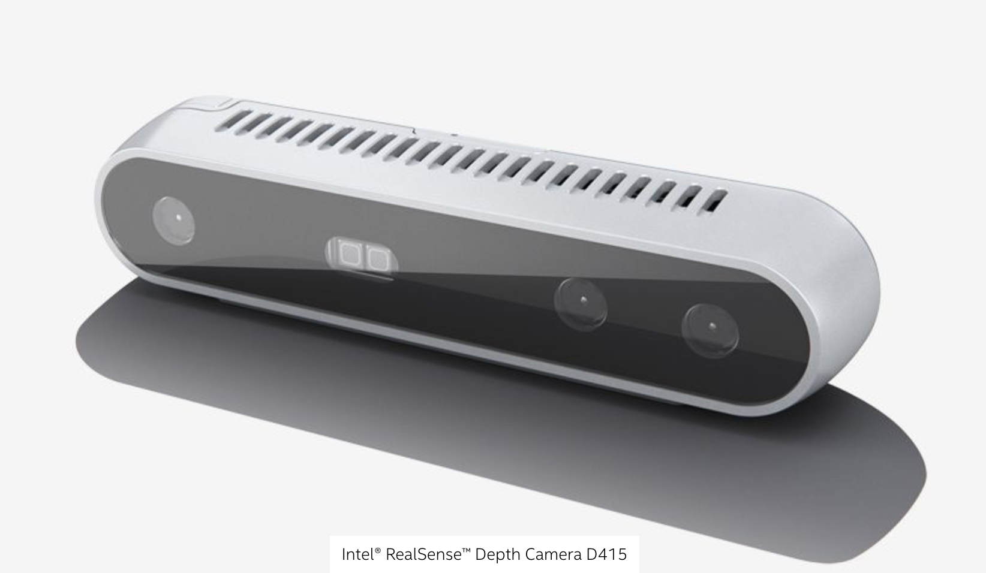
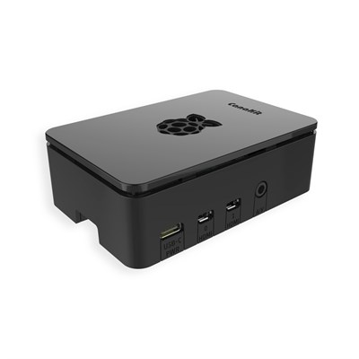
Final Concept
Point Design developed from trade studies.
Notes:
Humberto
Here, our goal is to present an idea of what our system will look like and how it will operate when its fully functional. This is what we intend to present on Design Day and it is our final deliverable
Here we present the final concept which is an outcome of the trade studies and concludes our first objective as we fully demonstrate understanding of how the final system shall operate to satisfy the given system requirements.

Slide 18
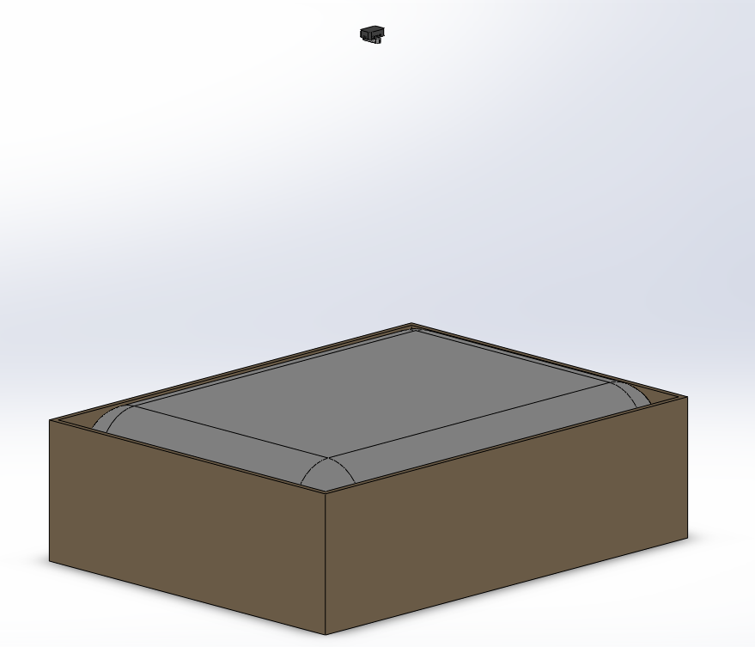
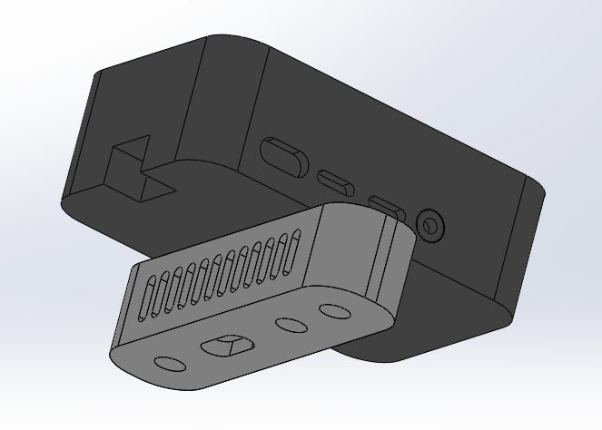
Final Concept
Point Design developed from trade studies.
Notes:
Humberto
Here, our goal is to present an idea of what our system will look like and how it will operate when its fully functional. This is what we intend to present on Design Day and it is our final deliverable
Here we present the final concept which is an outcome of the trade studies and concludes our first objective as we fully demonstrate understanding of how the final system shall operate to satisfy the given system requirements.

Slide 19
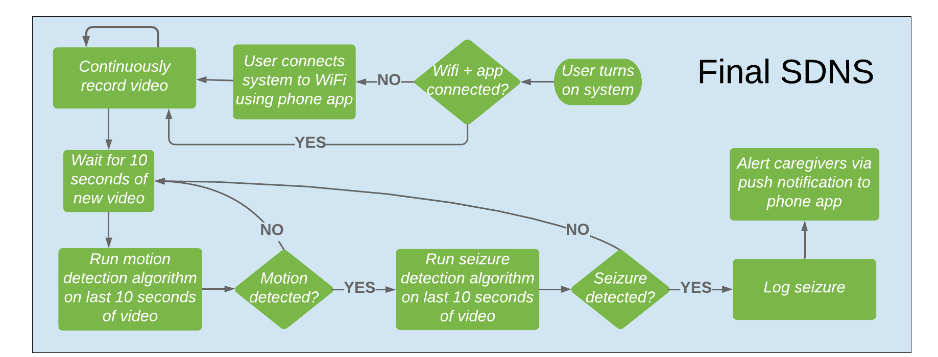
Final Concept: Software
Point Design developed from trade studies and discussions with sponsors.
Notes:
Gordon
Here, our goal is to present an idea of what our system will look like and how it will operate when its fully functional. This is what we intend to present on Design Day and it is our final deliverable
Here we present the final concept which is an outcome of the trade studies and concludes our first objective as we fully demonstrate understanding of how the final system shall operate to satisfy the given system requirements.

Slide 20
PDR Overview
Introduction
System Requirements Section
System Architecture
System Block Diagram
System Requirements and SRVM
Concept, Trade Studies and Point Design
Design Considerations
Trade Studies
Final Design Concept
Risk Analysis and Mitigation
System Architecture and Requirements Prioritization
Model & Analyses
MVP Description
Model and Analyses
Test Plans for MVP
Status, Deliverables and Cost Analysis
Summary

Slide 21
Risk Analysis
 | Risk Criticality
Likelihood | 5
 | 4
 | 3 |  |  | 2
 | 2 |  |  | 5 | 3, 4 | 1
 | 1
 |  | 1 | 2 | 3 | 4 | 5
 | Consequences
Primary Risks:
Accumulating real training data.
Relying on external entities to collect data.
Loss of communication with cloud service.
Loss of smartphone communication.
Transportation of technology.
Our MVP success is driven by how well we can mitigate the top 2 risks.
Notes:
Juan
Here we want to convey what our biggest risks are, given our resources, knowledge and time. Once identified, we will have generated a set of strategies to minimize such risk so that we can continue carrying on with the project on schedule.
On this side we present our risk analysis in which we have identified the main areas that present risk to our project. We also explain why our MVP is not driven by risk connecting with our second objective in slide 3.

Slide 22
Risk Analysis
Rank | Risk | Risk Description | Risk Response
1 | Accumulating real training data. | If we don't accumulate real data, we run the risk of not producing an accurate detection system. | Produce simulated data in absence of real data. Produce data through computational simulation of real data.
2 | Relying on external entities to collect data. | If the external entities do not setup correctly during clinical trial then we run the risk of not accumulating useful data. | Simulated data will be generate domestically to continue training.
3 | Loss of communication with cloud service. | If we lose communication with the cloud server, we run the risk of losing access to real data for domestic training. | Store backup data locally. Recover backup data through mail.
4 | Loss of smartphone communication. | If the Raspberry Pi loses connectivity with the smartphone we run the risk of losing notification functionality on system. | Ensure connectivity is unique. Analyze competing devices to identify commonly used signals.
5 | Transportation of technology. | If our system is not transported adequately, we run the risk of damaging/losing our product. | We have enough of a cushion on budget to acquire another system setup. Team member will serve as a courier for the technology.
Our MVP success is driven by how well we can mitigate the top 2 risks.
Notes:
Juan
Here we want to convey what our biggest risks are, given our resources, knowledge and time. Once identified, we will have generated a set of strategies to minimize such risk so that we can continue carrying on with the project on schedule.
On this side we present our risk analysis in which we have identified the main areas that present risk to our project. We also explain why our MVP is not driven by risk connecting with our second objective in slide 3.

Slide 23
PDR Overview
Introduction
System Requirements Section
System Architecture
System Block Diagram
System Requirements and SRVM
Concept, Trade Studies and Point Design
Design Considerations
Trade Studies
Final Design Concept
Risk Analysis and Mitigation
System Architecture and Requirements Prioritization
Model & Analyses
MVP Description
Model and Analyses
Test Plans for MVP
Status, Deliverables and Cost Analysis
Summary

Slide 24
System Architecture and Requirements Prioritization
The Agile process places emphasis on delivering value to the customer as soon as possible in the form of a MVP.
System requirements relevant to the MVP were identified and decomposed into subsystem requirements.
Those were then further prioritized by what would be delivered by CDR for the MVP.
MVP was defined using a portion of our system requirements.

Slide 25
System Architecture and Requirements Prioritization
System Requirement | Subsystem Requirement | Verification | Subsystem
SR1.1: The system shall capture images at a rate above 16 FPS. | 1.1.1: The system shall capture RGB images at a resolution of at least 1280x720 pixels | I | Image Capture
 | 1.1.2: The system shall capture RGB images at a rate of at least 16 FPS. | T | Image Capture
 | 1.1.3: The system shall create a depth map at a resolution of at least 640x480 and at a rate of at least 16 FPS. | T | Image Capture
Yellow = Part of MVP | 1.1.4: The system shall be able to save the images and depth maps captured. | I | Image Capture
Notes:
Louie
Here we explain which system requirements need attention from the beginning given that they present higher risk than others, thus should be tackled as soon as possible.
List the system requirements that were decomposed, the sub-system requirements with their verification type (A/T/I/D)
In this slide, we present our prioritization of system requirements, the decomposition of selected system requirements based off risk and critical technology, so that our MVP can provide value to our customer and can drive us to the finished system as a starting point.

Slide 26
System Architecture and Requirements Prioritization
System Requirement | Subsystem Requirement | Verification | Subsystem
SR1.2: The system shall perform steady-state processing at rate above 16 FPS. | 1.2.1: The system shall perform the motion detection algorithm at rate of at least 16 FPS. | T | Image Analysis
 | 1.2.2: The system shall perform the seizure detection algorithm at rate of at least 16 FPS. | T | Image Analysis
Yellow = Part of MVP | 1.2.3: The system shall use a Raspberry Pi and optional Neural Compute Sticks to analyze data from the Image Capture subsystem to detect a seizure. | T | Image Analysis
The MVP will focus on detecting motion
in a video and using that as training data.
Notes:
Louie
Here we explain which system requirements need attention from the beginning given that they present higher risk than others, thus should be tackled as soon as possible.
List the system requirements that were decomposed, the sub-system requirements with their verification type (A/T/I/D)
In this slide, we present our prioritization of system requirements, the decomposition of selected system requirements based off risk and critical technology, so that our MVP can provide value to our customer and can drive us to the finished system as a starting point.

Slide 27
System Architecture and Requirements Prioritization
System Requirement | Subsystem Requirement | Verification | Subsystem
SR1.3: The system shall detect a seizure with at least 90 percent accuracy. | 1.3.1: The system shall detect motion on data from the Image Capture subsystem. | T | Image Analysis
 | 1.3.2: The system shall detect motion through a bedsheet. | T | Image Analysis
Yellow = Part of MVP | 1.3.3: The system shall detect a seizure on data from the Image Capture subsystem. | T | Image Analysis
The MVP will focus on detecting motion
in a video and using that as training data.
Notes:
Louie
Here we explain which system requirements need attention from the beginning given that they present higher risk than others, thus should be tackled as soon as possible.
List the system requirements that were decomposed, the sub-system requirements with their verification type (A/T/I/D)
In this slide, we present our prioritization of system requirements, the decomposition of selected system requirements based off risk and critical technology, so that our MVP can provide value to our customer and can drive us to the finished system as a starting point.

Slide 28
System Architecture and Requirements Prioritization
System Requirement | Subsystem Requirement | Verification | Subsystem
SR1.5: The system shall operate independently from the presence of visible light, in room-ambient conditions. | 1.5.1: The Image Capture subsystem shall be able to gather relevant data in low light conditions. | T | Image Capture
 | 1.5.2: The Image Capture subsystem shall operate in room-ambient conditions | I | Image Capture
Yellow = Part of MVP | 1.5.3: The Image Analysis subsystem shall operate in room-ambient conditions | I | Image Analysis
The MVP will be able to operate in the same conditions
as the final product.
Notes:
Louie note that no notification sunsystem tasks will be targeted, but it will be worked in parallel
Here we explain which system requirements need attention from the beginning given that they present higher risk than others, thus should be tackled as soon as possible.
List the system requirements that were decomposed, the sub-system requirements with their verification type (A/T/I/D)
In this slide, we present our prioritization of system requirements, the decomposition of selected system requirements based off risk and critical technology, so that our MVP can provide value to our customer and can drive us to the finished system as a starting point.

Slide 29
PDR Overview
Introduction
System Requirements Section
System Architecture
System Block Diagram
System Requirements and SRVM
Concept, Trade Studies and Point Design
Design Considerations
Trade Studies
Final Design Concept
Risk Analysis and Mitigation
System Architecture and Requirements Prioritization
Model & Analyses
MVP Definition
Model and Analyses
Test Plans for MVP
Status, Deliverables and Cost Analysis
Summary

Slide 30
MVP Definition
MVP was defined based on the risk of gathering as much real clinical data
These system define what the minimum viable product shall be because it will allow us to use a depth camera (1.1) to gather and process training data (1.2, 1.3) while operating under dark or illuminated conditions at room-ambient conditions (1.4)
(Yellow = Fully applies to MVP)
1.1 | The system shall capture images at a rate above 16 fps.
1.2 | The system shall perform steady-state processing at rate above 16 fps.
1.3 | The system shall detect a seizure with at least 90 percent accuracy
1.5 | The system shall operate independently from the presence of visible light, in room-ambient conditions.
Notes:
Alejandro
Here the plan is to give a detailed description of our MVP so that our sponsor and mentors can observe how we have chosen this first deliverable based on our risk analysis, trade studies and requirements prioritization. The audience will be able to see how this MVP encompasses the most critical areas of our project and how such areas will start to be tackled early on.

Slide 31
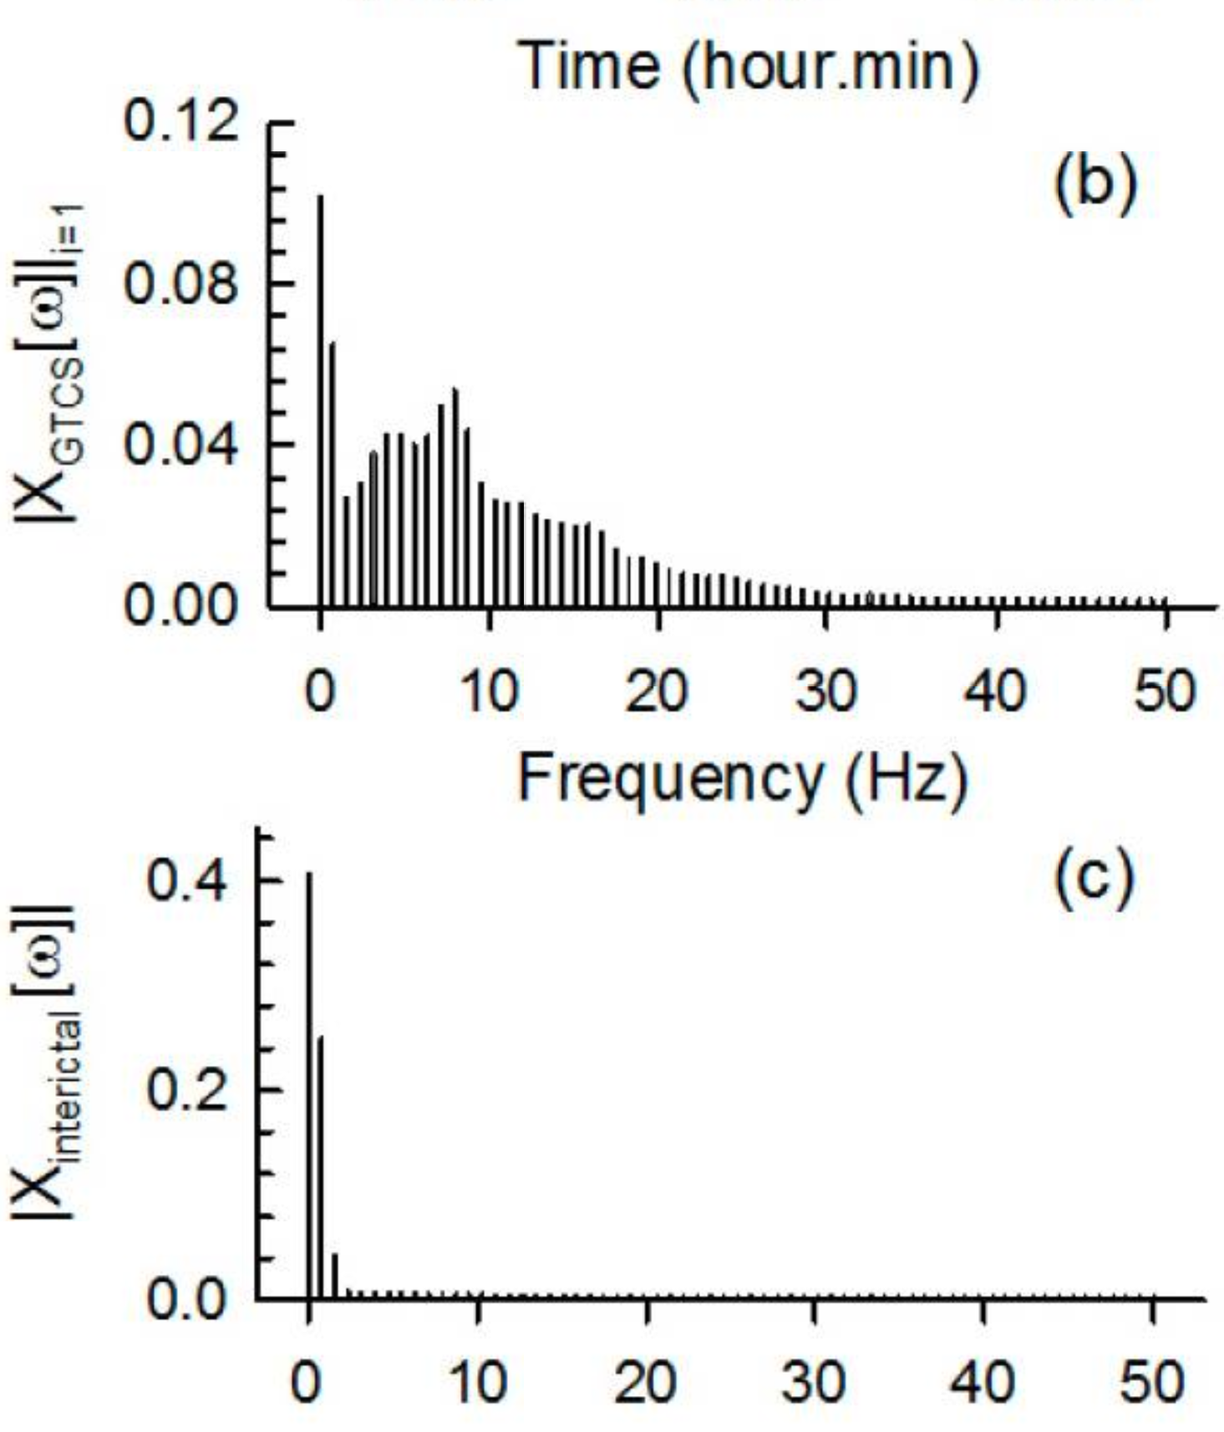
Models & Analyses
IR Stereo Camera can capture a depth map at a rate up to 90 fps with a resolution up to 1280x720.
The depth can be analyzed in a sliding time window of 10 seconds where the RMS can be calculated as the window slides every second.
In the same time window, a Fourier Analysis can be done to analyze data in a spectral domain.
This protects the privacy of the patient, as the depth map and the frequency data does not contain any private recognizable information about the patient.
Frequency analysis is a method that protects the patient and increases our chances of obtaining high detection accuracy.
Notes:
Alejandro
-Stretch goal of alarm to notify medication need.

Slide 32
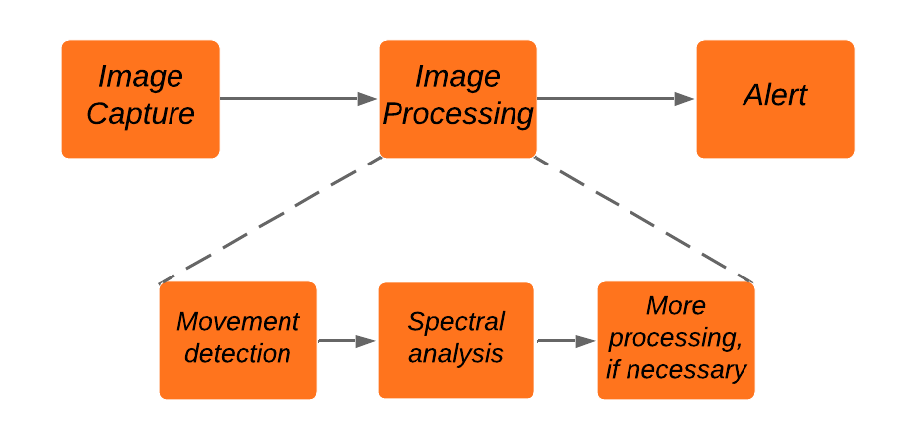
Models & Analyses
Final SDNS
Overall operation of the final system is based on three main stages.
Notes:
Gordon
-Stretch goal of alarm to notify medication need.

Slide 33
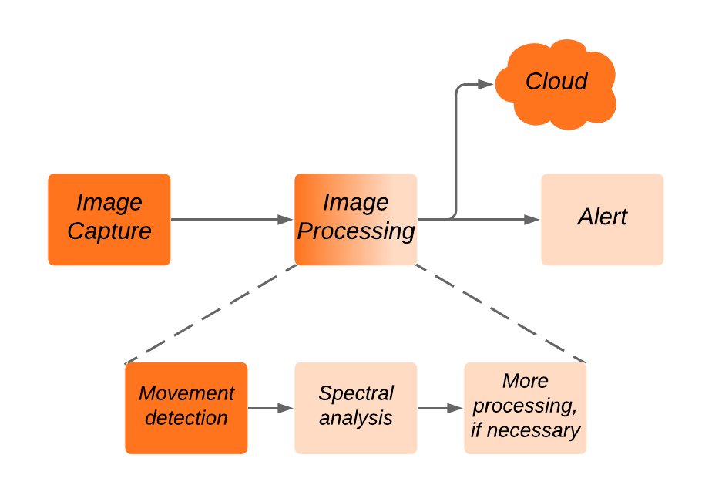
Models & Analyses
MVP SDNS
Our MVP will perform critical parts of the final image processing algorithm.
Notes:
Gordon
-Stretch goal of alarm to notify medication need.

Slide 34
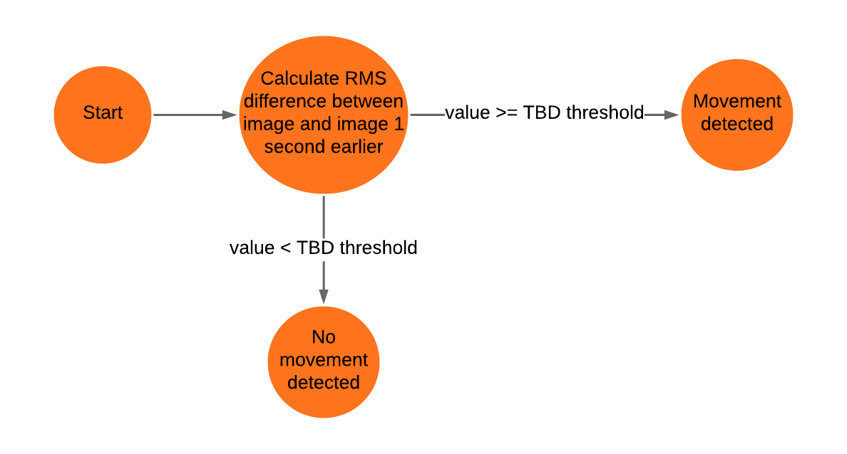
Models & Analyses
Movement detection algorithm
We have a strong movement detection algorithm ready to implement.
Notes:
Gordon
-Stretch goal of alarm to notify medication need.

Slide 35
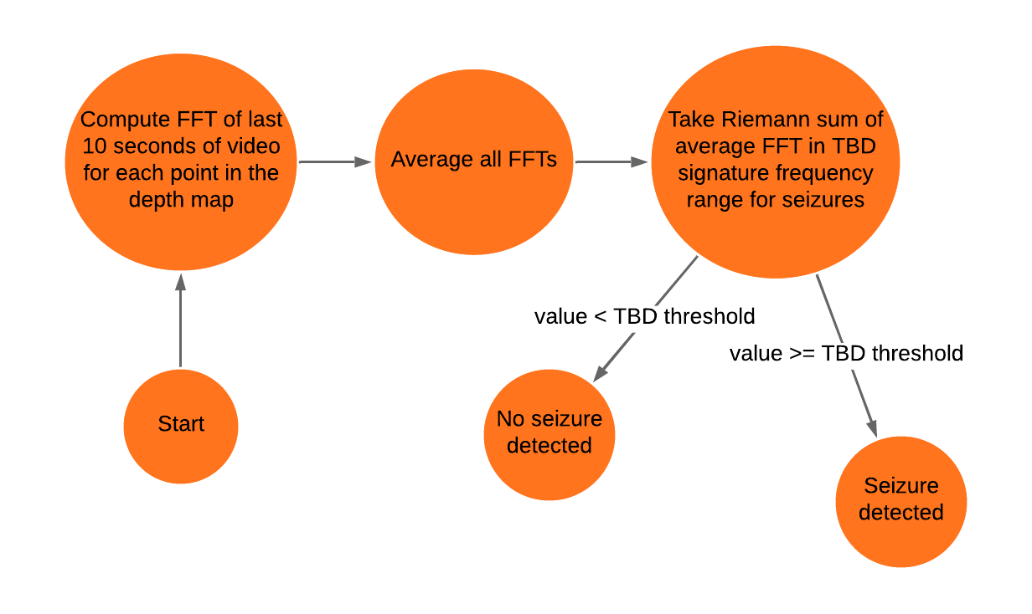
Models & Analyses
Seizure detection algorithm
We have a strong seizure detection algorithm ready to develop further.
Notes:
Gordon
-Stretch goal of alarm to notify medication need.

Slide 36
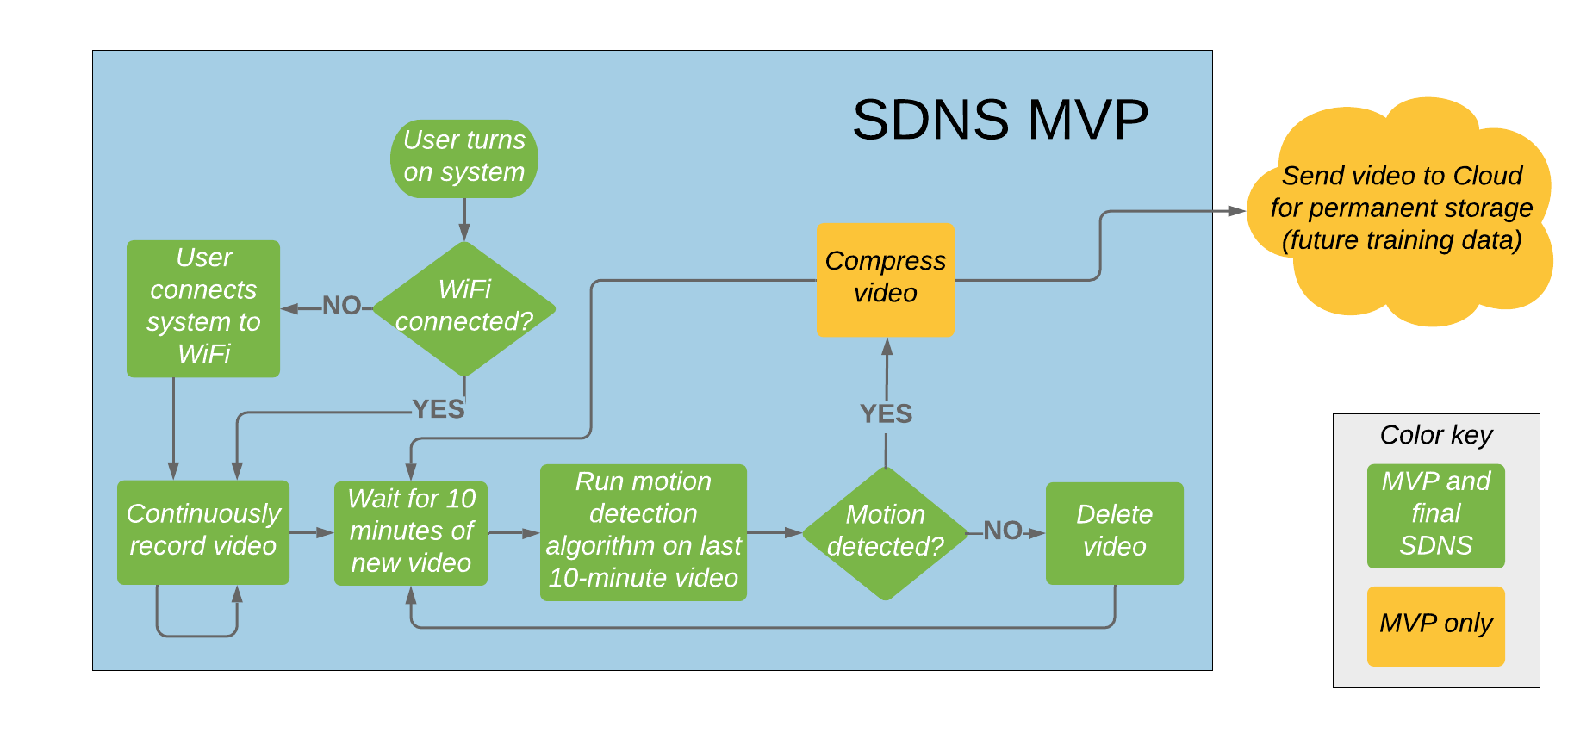
Models & Analyses
Our MVP software model is ready to be implemented.
Notes:
Gordon
SDNS MVP in grey, “MVP and final SDNS” in green, “MVP only” in yellow, “color key” in grey

Slide 37
PDR Overview
Introduction
System Requirements Section
System Architecture
System Block Diagram
System Requirements and SRVM
Concept, Trade Studies and Point Design
Design Considerations
Trade Studies
Final Design Concept
Risk Analysis and Mitigation
System Architecture and Requirements Prioritization
Model & Analyses
MVP Description
MVP Design
Test Plans for MVP
Status, Deliverables and Cost Analysis
Summary

Slide 38
Test Plan for MVP
MVP verification will start at the component level.
Subsystem verification is done by making sure subsystem requirements for the MVP are satisfied.
Subsystems will be integrated for final MVP verification.
Component Verification
Subsystem Verification
Integration Verification
MVP verification starts at the component level
and works to integration.
Notes:
Louie
Based on our MVP Definition, here we will explain how it should be verified so that by December, our MVP will have satisfied some of the system requirements of our project so that after that, we can focus on developing the remaining requirements and add functionality to the system based off that.
Presenting our tests plan for the MVP is a crucial part of the presentation as it explains to the customer and mentors how our proposed MVP is not only build able but also verifiable in terms of the system requirements that encompass such MVP. This connects with our third objective in slide 3 about demonstrating verification methods for our MVP to show we are ready to build and verify it.

Slide 39
Test Plan for MVP
The verification will start with SR1.5: The system shall operate in dark, room-ambient conditions.
Camera and computer trade studies factored in the need to fulfill this requirements.
Subsystem Requirement | Verification
1.5.1: The Image Capture subsystem shall be able to capture images in low light conditions. | T
1.5.2: The Image Capture subsystem shall operate in room-ambient conditions | I
1.5.3: The Image Analysis subsystem shall operate in room-ambient conditions | I
Notes:
Louie
Based on our MVP Definition, here we will explain how it should be verified so that by December, our MVP will have satisfied some of the system requirements of our project so that after that, we can focus on developing the remaining requirements and add functionality to the system based off that.
Presenting our tests plan for the MVP is a crucial part of the presentation as it explains to the customer and mentors how our proposed MVP is not only build able but also verifiable in terms of the system requirements that encompass such MVP. This connects with our third objective in slide 3 about demonstrating verification methods for our MVP to show we are ready to build and verify it.

Slide 40
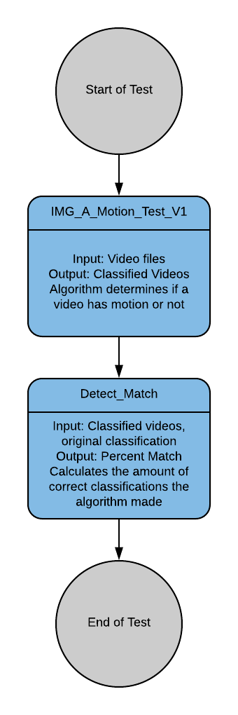
Test Plan for MVP
Requirement 1.3.1: The system detect motion on data from the Image Capture subsystem.
Environment: The software test will be performed on a Raspberry Pi 4 using Ubuntu Desktop 18.04 where only the Image Capture subsystem, Image Analysis subsystem and testing software will be active.
Input: IMG_A_Motion_Test_V1 shall feed pre-classified video and data of someone moving into the Image Analysis subsystem.
Outcome: The algorithm subsystem will classify the data it is given as “Movement” or “No Movement”. The results will be compared to the original classifications. The test passes if 90 % match is achieved.

Slide 41
Test Plan for MVP
Integration Verification
Once MVP system and subsystem requirements have been verified individually the MVP will be tested as a complete system.
The verification will involve having the system fully set-up and movement under a sheet will be done to test for detection.
The MVP will also be tested for the ability to send video to a cloud server.
Testing procedure will be refined and expanded
throughout the creation of CDR.

Slide 42
PDR Overview
Introduction
System Requirements Section
System Architecture
System Block Diagram
System Requirements and SRVM
Concept, Trade Studies and Point Design
Design Considerations
Trade Studies
Final Design Concept
Risk Analysis and Mitigation
System Architecture and Requirements Prioritization
Model & Analyses
MVP Description
Model and Analyses
Test Plans for MVP
Status, Deliverables and Cost Analysis
Summary

Slide 43
Preliminary Cost Analysis
INITIAL BUDGET | $ 4,000.00
ITEM | QUANTITY | UNIT PRICE | TOTAL
CanaKit Raspberry Pi 4 4GB Starter Kit - 4GB RAM | 1 | $ 108.59 | $ 108.59
Jira Membership | 1 | $ 56.00 | $ 56.00
Polo Shirts | 6 | $ 25.00 | $ 150.00
Intel RealSense D415 | 1 | $ 165.41 | $ 165.41
MVP TOTAL |  |  | $ 480
The project has sufficient resources to complete the work.
Notes:
Here, this slide presents a cost analysis done until now, which explains how much money has been spent so far, and what other expenses we will incur in the next couple months. This supports our thesis statement as it demonstrates we have a clear financial overview of our project, validating our desire to start building the MVP.

Slide 44
Preliminary Cost Analysis
FUTURE PURCHASES
ITEM | QUANTITY | UNIT PRICE | TOTAL
CanaKit Raspberry Pi 4 4GB Starter Kit - 4GB RAM | 3* | $ 108.59 | $ 325.77
Intel RealSense D415 | 3* | $ 165.41 | $ 496.23
Design Day Poster | 1 | $ 150.00 | $ 150.00
Mounting System | 1 | $ 200.00 | $ 200.00
Training Algorithm | 1** | $ 800.00 | $ 800.00
TOTAL COSTS |  |  | $ 1,972.00
The project has sufficient resources to complete the work.
Notes:
Here, this slide presents a cost analysis done until now, which explains how much money has been spent so far, and what other expenses we will incur in the next couple months. This supports our thesis statement as it demonstrates we have a clear financial overview of our project, validating our desire to start building the MVP.

Slide 45
Preliminary Cost Analysis
Note:
*Additional CanaKit Raspberry Pi 4 4GB Starter Kit - 4GB RAM and Intel RealSense D415 will be purchased for clinical trials.
** Training Algorithm could be removed from budget, due to possibility of using UA High Performance Computers for same purposes.
The project has sufficient resources to complete the work.
Notes:
Here, this slide presents a cost analysis done until now, which explains how much money has been spent so far, and what other expenses we will incur in the next couple months. This supports our thesis statement as it demonstrates we have a clear financial overview of our project, validating our desire to start building the MVP.

Slide 46
Project Milestones
Unsolicited Proposal | September 12, 2019
System Requirements Document (SRD) | October 1, 2019
Preliminary Design Review (PDR) | October 29, 2019
Critical Design Review (CDR) | December 3, 2019
Critical Design Review and Report | January 25, 2020
Integration Status Review (ISR) | March 3, 2020
Final Acceptance Review (FAR) | April 23, 2019
Design Day | May 4, 2020
Customer Satisfaction Report (CSR) | May 13, 2020
Project Milestones are set and understood.
Notes:
Here, the objective is to present a minimum number of deliveries in which oir system will be augmented each time, with more and more system requirements being verified at each stage until we reach design day and deliver the final system
This slide serves the purpose of visually portraying the different milestones proposed for this project as well as the deliverables that will be shown in each review date.

Slide 47
Project Deliverables
Proposal | ✔️
PDR Package | ✔️
CDR (Ready MVP ➝ Clinical Trials)
CDR Report MVP Document (SBD, SDD, SRVM, SRD, TPs)
ISR Changes since CDR, Part status, TDP, Budget, Conclusions
FAR Changes since ISR, FAT, Budget, Deliverables
Final Report Full TDP
Design Day
Project Deliverables are defined and understood.
Notes:
Here, the objective is to present a minimum number of deliveries in which oir system will be augmented each time, with more and more system requirements being verified at each stage until we reach design day and deliver the final system
This slide serves the purpose of visually portraying the different milestones proposed for this project as well as the deliverables that will be shown in each review date.

Slide 48
AGILE Project Planning
CDR
SR 1.1: Capture images at ≥16 fps rate
1.4: Operate at desired light cond.
SSR 1.2.1: Detect motion at ≥16 fps rate
1.3.1: Detect motion
1.3.2: Detect motion through bed sheet
ISR
SR 1.2: Perform steady-state processing at ≥16 fps
2.2: Deliver alerts to users wiresely
3.1: Keep log file with seizure info
3.2: Output log file on command
SSR 2.1.1: Notification data package when motion detected
2.1.4: Trigger alarm with detected motion
FAR
SR 1.3: Detect seizure ≥90 % accuracy
2.1: Trigger alarm when seizure detected
2.3: Alarm triggered within 5 sec of seizure detected
The MVP will evolve to include all system requirements and capabilities based on an agile process.
Notes:
Here we propose deliverables by each review date so that the sponsor can get a sight if the added value over time of the project and how the MVP will tangibly transform into the final system. This connects with our thesis statement by demonstrating comprehension of the project and it’s stages.

Slide 49
PDR Overview
Introduction
System Requirements Section
System Architecture
System Block Diagram
System Requirements and SRVM
Concept, Trade Studies and Point Design
Design Considerations
Trade Studies
Final Design Concept
Risk Analysis and Mitigation
System Architecture and Requirements Prioritization
Model & Analyses
MVP Description
Model and Analyses
Test Plans for MVP
Status, Deliverables and Cost Analysis
Summary

Slide 50
Summary
We understand the functional and system requirements that encompass both the final product and the MVP
We have done trade studies that lead us to define our point design
We have identified the most critical risks to our project, and have defined strategies to mitigate them
We have prioritized system requirements based on risk analysis which will encompass our MVP
We have done models and analyses to support our design and prioritization decisions.
We have defined testing protocols to verify the SR’s and SSR’s that encompass the MVP
We understand the deliverables and their due dates, as well as the financial status of our project
We are ready to build and verify our MVP.
Notes:
Here we summarize all the information presented focusing on our understanding of the requirements of the system, risk, and how we used such categories to choose an MVP and show that we are ready to build it.

Slide 51
Epileptic Seizure Detection and Notification System
Preliminary Design Review
Thank You

Slide 52
Backup slides

Slide 53
Test Plan for MVP
SR1.1 and its subsystem requirements verification occur at the component level as well.
Subsystem Requirement | Verification
1.1.1: The system shall capture RGB images at a resolution of at least 1280x720 pixels | I
1.1.2: The system shall capture RGB images at a rate of at least 16 FPS. | I
1.1.3: The system shall create a depth map at a resolution of at least 640x480 and at a rate of at least 16 FPS. | I
1.1.4: The system shall be able to save the images and depth maps captured. | I

Slide 54
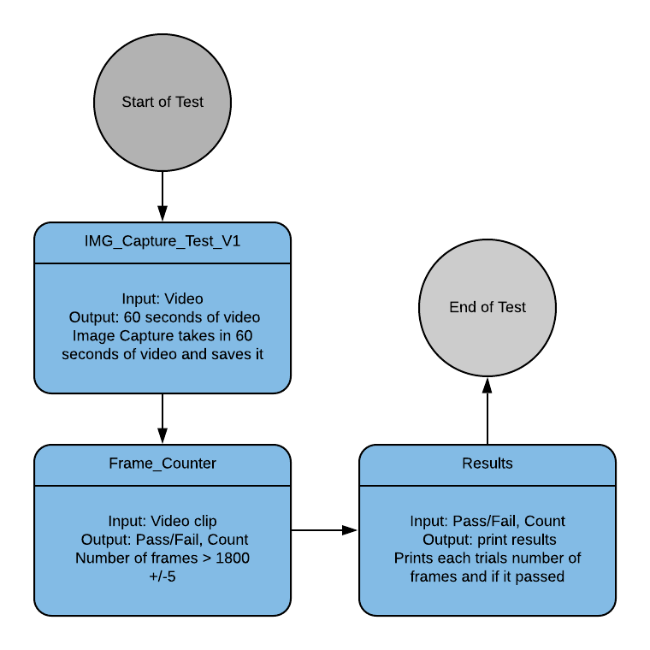
Test Plan for MVP
Requirement SR1.1.2: The system shall capture images at a rate of at least 16 FPS.
Environment: The software test will be performed on a Raspberry Pi 4 using Ubuntu Desktop 18.04 where only the Image Capture subsystem and testing software will be active.
Input: IMG_Capture_Test_V1 shall be run on the Raspberry Pi 4 10 times. The test shall capture 60 seconds of video on each run.
Outcome: The test will yield 10 60-second video clips. The number of frames captured in each clip will be counted using a Python script. The Requirement SR1.1.2 will be verified if all the clips have at least (16 frames) * (60 seconds) +/- 2 frames.

Slide 55
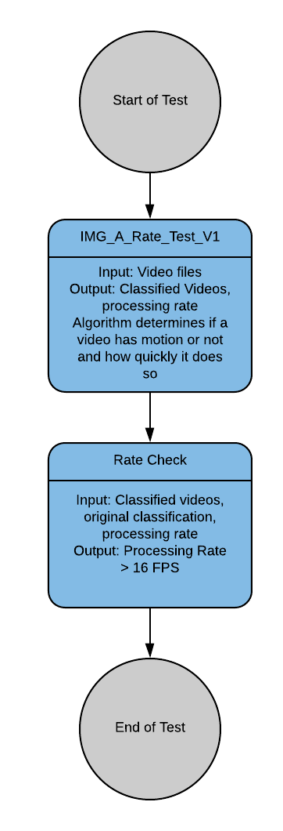
Test Plan for MVP
Requirement 1.2.1: The system shall perform the motion detection algorithm at rate of at least 16 FPS.
Environment: The software test will be performed on a Raspberry Pi 4 using Ubuntu Desktop 18.04 where only the Image Capture subsystem, Image Analysis subsystem and testing software will be active.
Input: IMG_A_Rate_Test_V1 shall feed pre-classified video and data of someone moving into the Image Analysis subsystem.
Outcome: The algorithm subsystem will classify the data it is given as “Movement” or “No Movement” and the rate of which frames are processed will be monitored. The results will be compared to the original classifications. The test passes if the algorithm detects motion at a rate greater than 16 frames per second.

Slide 56
Test Plan for MVP
By December system will be able to take in data in the form of video and depth maps, and an algorithm will be able to analyze that data.
Hooks in the system will allow us to upload data from the MVP to the cloud for further analysis.
MVP will be ready to start collecting data
Notes:
Louie
Based on our MVP Definition, here we will explain how it should be verified so that by December, our MVP will have satisfied some of the system requirements of our project so that after that, we can focus on developing the remaining requirements and add functionality to the system based off that.
Presenting our tests plan for the MVP is a crucial part of the presentation as it explains to the customer and mentors how our proposed MVP is not only build able but also verifiable in terms of the system requirements that encompass such MVP. This connects with our third objective in slide 3 about demonstrating verification methods for our MVP to show we are ready to build and verify it.

Slide 57
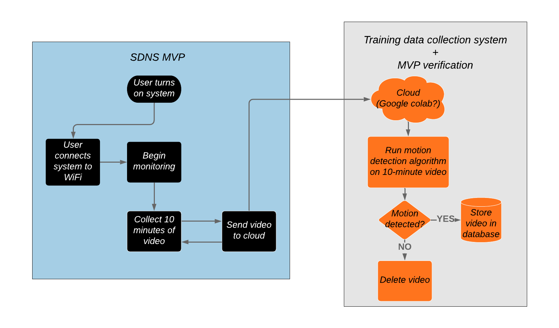
MVP software configuration with motion detection algorithm on cloud
An alternative model for MVP verification is ready to be implemented
Notes:
Alejandro and Gordon
-Stretch goal of alarm to notify medication need.

Slide 58
Camera Trade Study
Active IR Stereo Camera Best Choice (1=Worst Choice 10=Best Choice)
Trade Factors | Weight | Intel RealSense R200 |  | Intel RealSense D415 |  | eYs3D eSP870
 |  | Score | Factor Total | Score | Factor Total | Score | Factor Total
Performance Best-Choice | 9 | 6.4 | 57.6 | 8.4 | 75.6 | 5.8 | 52.2
Accuracy | 9 | 6 | 54 | 9 | 81 | 4 | 36
FOV | 6 | 6 | 36 | 8 | 48 | 7 | 42
Depth resolution | 8 | 5 | 40 | 9 | 72 | 6 | 48
Connectivity | 7 | 8 | 56 | 8 | 56 | 8 | 56
FPS | 6 | 7 | 42 | 8 | 48 | 4 | 24
Schedule Best-Choice | 5 | 9 | 45 | 8 | 40 | 6 | 30
Cost Best-Choice | 6 | 8 | 48 | 7 | 42 | 6 | 36
Total Score |  | 150.6 |  | 157.6 |  | 118.2
 | RealSense R200 | RealSense D415 | eYs3D eSP870
Accuracy | More than 3cm error at 2m | <= 2%, which is 3cm at 1.5m distance | <= 7.43 cm at 1.5m
FOV | H 59 +/- 5° V 46 +/- 5° D 70 +/- 4.5° | H 69.4° V42.5° D77° | H 63.2° V 42°
Depth resolution | 628x468 | 1280x720 | 640x480
Connectivity | USB 3.0 | USB 3.0 Type-C | USB 3.0
Depth FPS | 60 | 90 | 30
Lead time | Already have it | 3 days | 3-11 days
Cost | $75.00 | $144 | $179
Production status | Discontinued | Current | Current
Notes:
Active IR Camera trade Study was done with the information found in the datasheets found online on the manufacturers' websites. Information was summarized in the table below
R200
https://www.intel.com/content/dam/support/us/en/documents/emerging-technologies/intel-realsense-technology/realsense-camera-r200-datasheet.pdf
D415
https://www.mouser.com/pdfdocs/Intel_D400_Series_Datasheet.pdf
eYe3D
https://cdn.sparkfun.com/assets/6/5/9/1/8/eAP87003C_EX8029_Datasheet_Non-NDA-Rev1.0.pdf

Slide 59
Image Analysis Algorithm Trade Study
Image Analysis Algorithm Best Choice (1=Worst Choice 10=Best Choice)
Trade Factors | Weight | Neural network directly on camera output |  | Out-of-the-box pose estimation followed by NN seizure classif. |  | Frequency analysis with gradient descent of a few parameters
 |  | Score | Factor Total | Score | Factor Total | Score | Factor Total
Performance Best-Choice | 10 | 5.2 | 51.7 | 7.2 | 71.7 | 7.3 | 73.3
Amount of training data required | 9 | 3 | 27 | 5 | 45 | 10 | 90
Difficulty of obtaining relevant training data | 7 | 5 | 35 | 4 | 28 | 9 | 63
Computational load for training | 5 | 3 | 15 | 6 | 30 | 9 | 45
Ease of expanding capabilities | 6 | 8 | 48 | 10 | 60 | 3 | 18
Generalizability in other settings | 6 | 3 | 18 | 10 | 60 | 8 | 48
Ability to interface with hardware | 5 | 9 | 45 | 8 | 40 | 5 | 25
Schedule Best-Choice | 8 | 4 | 32 | 4 | 32 | 8 | 64
Cost Best-Choice | 6 | 3 | 18 | 5 | 30 | 9 | 54
Total Score |  | 101.7 |  | 133.7 |  | 191.3
 | NN on camera | Pose est -> NN | Freq analysis
Amount of training data required | Order of 100,000 samples | Order of 10,000 samples | Order of 100 samples
Difficulty of obtaining relevant training data | Need RGB videos of seizures | Need depth map videos of seizures | May be able to use many sources of training data (find char. freq.)
Computational load for training | Large amount of training req | Moderate amount of training req | Small amount of training req
Ease of expanding capabilities | Easy to add hooks for more inputs + outputs | Easy to add hooks to 2nd NN for more inputs + outputs | Hooks and new features non-trivial to implement
Generalizability in other settings | NN very specific to angle, setting | NN independent of angle, setting | indep. of angle & setting, but observed freqs may change
Ability to interface with hardware | One NN with neural compute sticks | Two NNs with neural compute sticks | Tricky to interface with NCSs
Schedule | Hard to get training data, easy NN | Easier to get train data, harder NN | Easy to implement algorithm
Cost | Large amount of cloud training req | Moderate amount of cloud training | Small amount of cloud training
Notes:
Active IR Camera trade Study was done with the information found in the datasheets found online on the manufacturers' websites. Information was summarized in the table below
R200
https://www.intel.com/content/dam/support/us/en/documents/emerging-technologies/intel-realsense-technology/realsense-camera-r200-datasheet.pdf
D415
https://www.mouser.com/pdfdocs/Intel_D400_Series_Datasheet.pdf
eYe3D
https://cdn.sparkfun.com/assets/6/5/9/1/8/eAP87003C_EX8029_Datasheet_Non-NDA-Rev1.0.pdf

Slide 60
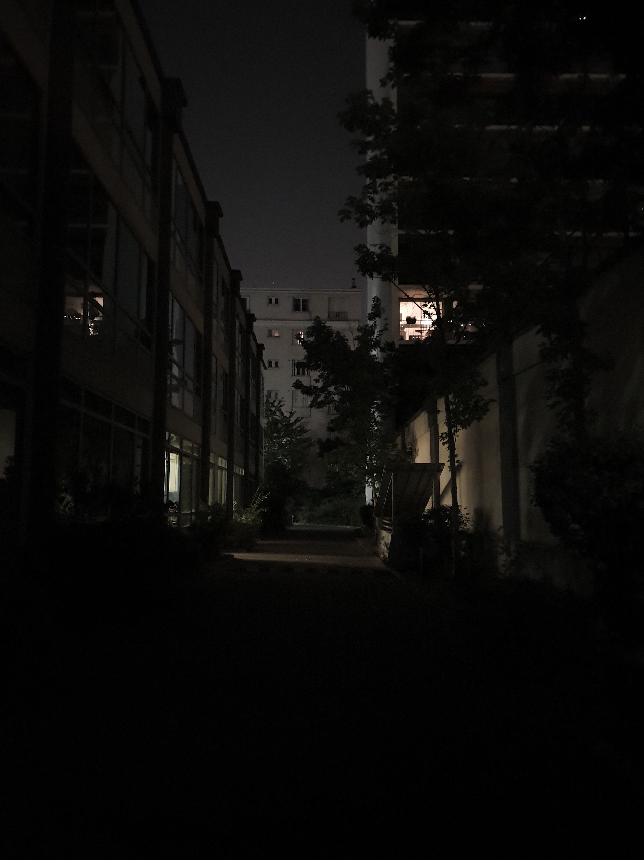

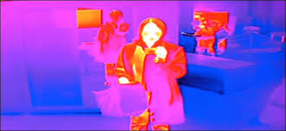
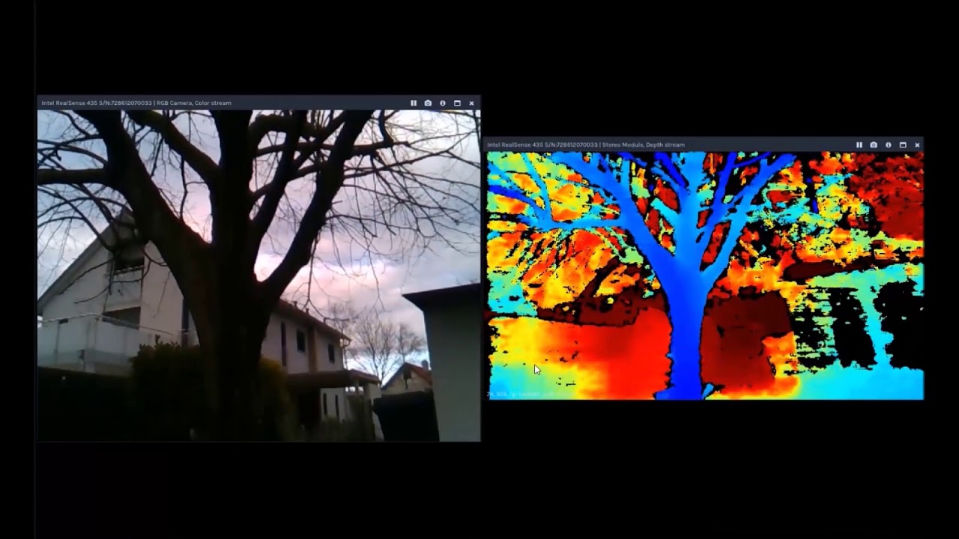
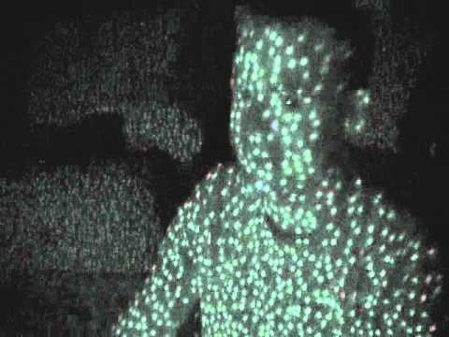
Type of Camera Trade Study
Low Light Use: (left to right: RGB, Near-IR, Thermal, Active IR Stereo

Slide 61
Type of Camera Trade Study
Sensitivity:
RGB: Resolutions up to 4K, 1080p resolution achievable in cheap sensors
Near-IR: typically up to 640x512 https://lot-qd.de/en/products/imaging/near-infrared-and-shortwave-infrared-cameras/
Thermal camera: For inexpensive sensor (below $500) 0.25 °C but with very low resolution (64 pixels total). https://cdn-learn.adafruit.com/assets/assets/000/043/261/original/Grid-EYE_SPECIFICATIONS%28Reference%29.pdf?1498680225
Active IR Stereo: Depth map with a resolution up to 1280x720 pixels, 10 bit. (Realsense D415)

Slide 62
Trade Studies
Computer Trade Study
Computer Best Choice
Trade Factors | Weight | Intel NUC Kit NUC7i7BNH |  | Raspberry Pi 4 Model B |  | Udoo x86 Ultra
 |  | Score | Factor Total | Score | Factor Total | Score | Factor Total
Performance Best-choice | 9 | 7.4 | 66.6 | 5.2 | 46.8 | 6.4 | 57.6
RAM | 9 | 9 | 81 | 5 | 45 | 7 | 63
CPU | 8 | 8 | 64 | 5 | 40 | 7 | 56
Connectivity | 7 | 6 | 42 | 5 | 35 | 7 | 49
Ports | 3 | 7 | 21 | 6 | 18 | 4 | 12
Operating system | 5 | 7 | 35 | 5 | 25 | 7 | 35
Schedule Best-choice | 4 | 6 | 24 | 6 | 24 | 6 | 24
Cost Best-choice | 6 | 4 | 24 | 8 | 48 | 6 | 36
Total Score |  | 114.6 |  | 118.8 |  | 117.6

Slide 63
Notification App Trade Study
Design Considerations:
Able to be developed, tested, and used by the whole team
Lowest barrier to entry possible for programing
Can support key function of communicating with a Raspberry Pi
Low risk aspect to project
Design Concept:
Create app that receive data from Raspberry Pi
Use a flexible, adaptable system
Must be able to access alarm system on platform
Testable
iOS
Android
NativeScript
Contract Out
Existing App

Slide 64
Trade Studies
Notification App Trade Study
Type of Notification App Development
Trade Factors | Weight | iOS |  | Android |  | Both(NativeScript or Other) |  | Contract Out
 |  | Score | Factor Total | Score | Factor Total | Score | Factor Total | Score | Factor Total
Performance Risks | 8 | 5.14 | 41.14 | 6.14 | 49.14 | 6.71 | 53.71 | 7.14 | 57.14
Ease of Dev | 8 | 3 | 24 | 7 | 56 | 8 | 64 | 10 | 80
Communication | 9 | 5 | 45 | 7 | 63 | 8 | 72 | 4 | 36
Adaptability | 5 | 4 | 20 | 5 | 25 | 6 | 30 | 2 | 10
Reliability | 10 | 8 | 80 | 5 | 50 | 7 | 70 | 8 | 80
UI/UX | 3 | 8 | 24 | 6 | 18 | 7 | 21 | 8 | 24
Language | 6 | 3 | 18 | 8 | 48 | 8 | 48 | 9 | 54
Testing | 7 | 5 | 35 | 5 | 35 | 3 | 21 | 9 | 63
Schedule Risk | 5 | 7 | 35 | 8 | 40 | 8 | 40 | 4 | 20
Cost Risk | 2 | 5 | 10 | 8 | 16 | 8 | 16 | 1 | 2
Total Score |  | 86.14 |  | 105.14 |  | 109.71 |  | 79.14

Slide 65
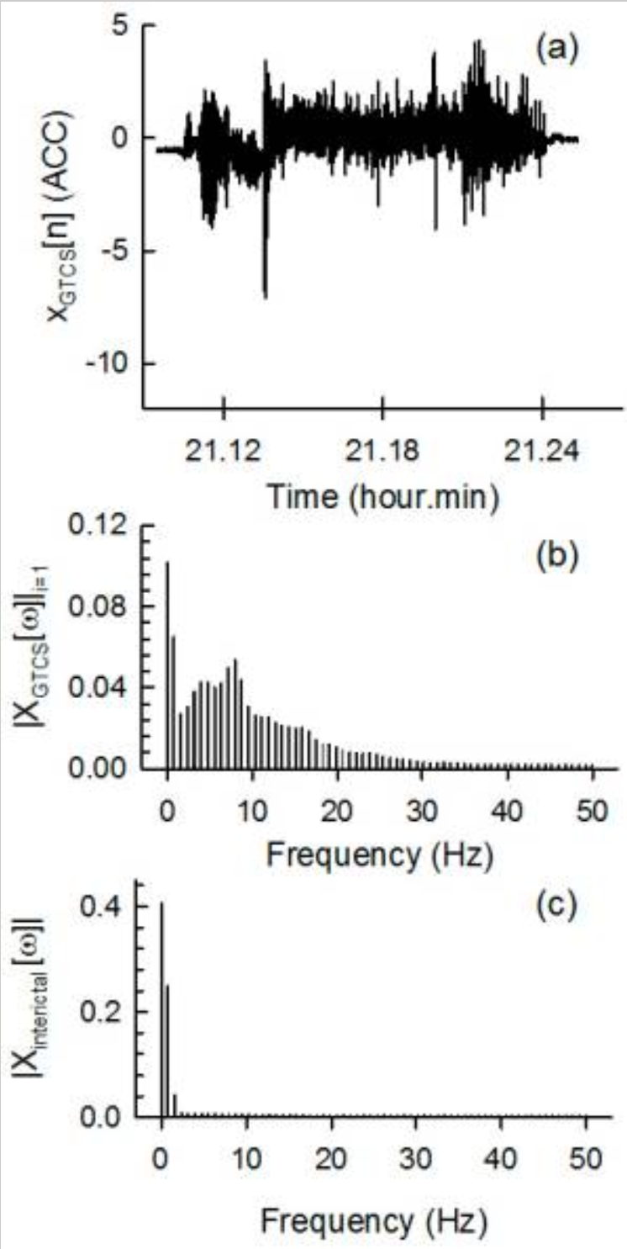
Spectral Approach
Paper from 2017 by Joo, Han, Lee, Yang, Kang & Woo.
Describe the use of gyroscopes and analyzing data in a spectral domain.
Very characteristic frequency regions were found for Tonic-Clonic Seizures when compared to the interictal (between seizures) data.
https://www.ncbi.nlm.nih.gov/pmc/articles/PMC5375767/

Slide 66
Bitrates for sending data to cloud
According to our sponsors at Intel (subject matter experts), our RealSense color video (720p at 30 fps) can be compressed at ~1 Mbps using HEVC (High Efficiency Video Coding).
1 Mbps = ⅛ MBps = 7.5 MB/min
Color video:depth video is 3:1 in bits per pixel, so:
Total for both video streams is 10 MB/min
An alternative model for MVP verification is ready to be implemented
Notes:
Alejandro and Gordon
-Stretch goal of alarm to notify medication need.

